Slide 1





NUMBER GUESSING GAME
Team Members:
Vikas Kumar-2001610100240
Sudhanshu Singh -2001610100217
Priyesh Dwivedi-2001610100159
Vishal Dhiman-2001610100244
Guide:KAUSHAL SIR
Disclaimer: The content is curated for educational purposes only.

Slide 2
OUTLINE
Abstract
Problem Statement
Aims, Objective & Proposed System/Solution
System Design/Architecture
System Development Approach (Technology Used)
Algorithm & Deployment
Conclusion
Future Scope
References
Video of the Project
Notes:
These are the list of chapters that we are going to cover in these foundation codes. Those are chapter one what are AI and ML? chapter 2 applied Python programming in AI, and chapter 3 is exploratory data analysis for ML.

Slide 3
Abstract Guessing Game is a project that highlights the importance of one of the games that are of most prominence. The number guessing game can allow the users in guessing the numbers that display on the screen. It can also help the children to use the umber guessing game as it can provide them the practice in guessing the numbers. The usage of the number guessing game is easily available through the use of this report.

Slide 4
Problem Statement The user has to input a number within the given range. The system determines if the user has entered a correct number or not If the number is higher or lower than the correct number then appropriate message is displayed.

Slide 5
Aim and Objective Number Guessing Game or “Guess A Number” is a very simple and short JavaScript gaming mini project. This game is built for students who are looking for mini-game in Java Script . A number guessing game is a simple guessing game where a user is supposed to guess a number between 0 and 100 in a maximum of 10 attempts. The game will end after 10 attempts and if the player failed to guess the number, and then he loses the game.

Slide 6
Proposed Solution Games are popular means of fun and entertainment for people of all age groups. It provides an excellent source of rest and relaxation for adults, and a innovating and invigorating challenge to younger children. Random number guessing game is a new type of challenge to a younger audience and a nostalgic challenge to adults. The user has to input a number within the given range .The system determines if the user has entered a correct number or not If the number is higher or lower than the correct number then appropriate message is displayed.

Slide 7
System Architecture SYSTEM REQUIREMENTS ❑ Operating System: Windows/Mac ❑ RAM: 4GB ❑ Processor: 64x 1.0Ghz processor ❑ ROM: 8GB CODE EDITORS USED Visual Studio Code Visual Studio Code is a lightweight, open-source code editor by Microsoft. Featuring multi-language support, intelligent code completion, debugging tools, and a rich extension ecosystem, it offers a user-friendly interface and cross-platform compatibility. Its active community and constant updates contribute to its widespread popularity among developers for efficient coding.

Slide 8
System Deployment Approach HTML HTML (Hypertext Markup Language) is the standard language for creating web pages. Using tags, it structures content like text, images, and links. HTML5, the latest version, introduces new elements for multimedia and improved semantics. CSS CSS (Cascading Style Sheets) is a crucial web development language used to style and format HTML documents. Employing selectors, properties, and values, CSS enhances the visual presentation of websites. JavaScript JavaScript is a versatile scripting language widely used in web development. Executed on the client-side, it enhances interactivity and dynamic content in browsers.

Slide 9
Algorithm & Deployment Algorithm: Provide a high-level overview of the algorithm used for the game . Explain how a random number is generated and how user guesses are compared . Deployment: Provide instructions on how to deploy the game. Mention that the code can be embedded in an HTML file. Optionally, include screenshots or steps for setting up a basic HTML file.

Slide 10
Conclusion My Guessing Game is where you put a number in the input and press the button. If the number is too high it will go through the flow chart and then it will come up in the output box that your number is too high. If the number you put in was too low then it would go through the flow chart and in the output box it would tell you that your number was too low whereas if you got the number correct it would also go through the flowchart but would tell you in the output box it would say that until you got the number spot on. This will keep happening until you get the right number.

Slide 11
Future Scope A number guessing game is a simple guessing game where a user is supposed to guess a number between 0 and N in a maximum of 10 attempts. The game will end after 10 attempts and if the player failed to guess the number, and then he loses the game

Slide 12
Reference
http://www.oreilly.com/data/free/the-new-artificial-intelligence-market.csp
Notes:
Reference
These are the references for this session.
12

Slide 13
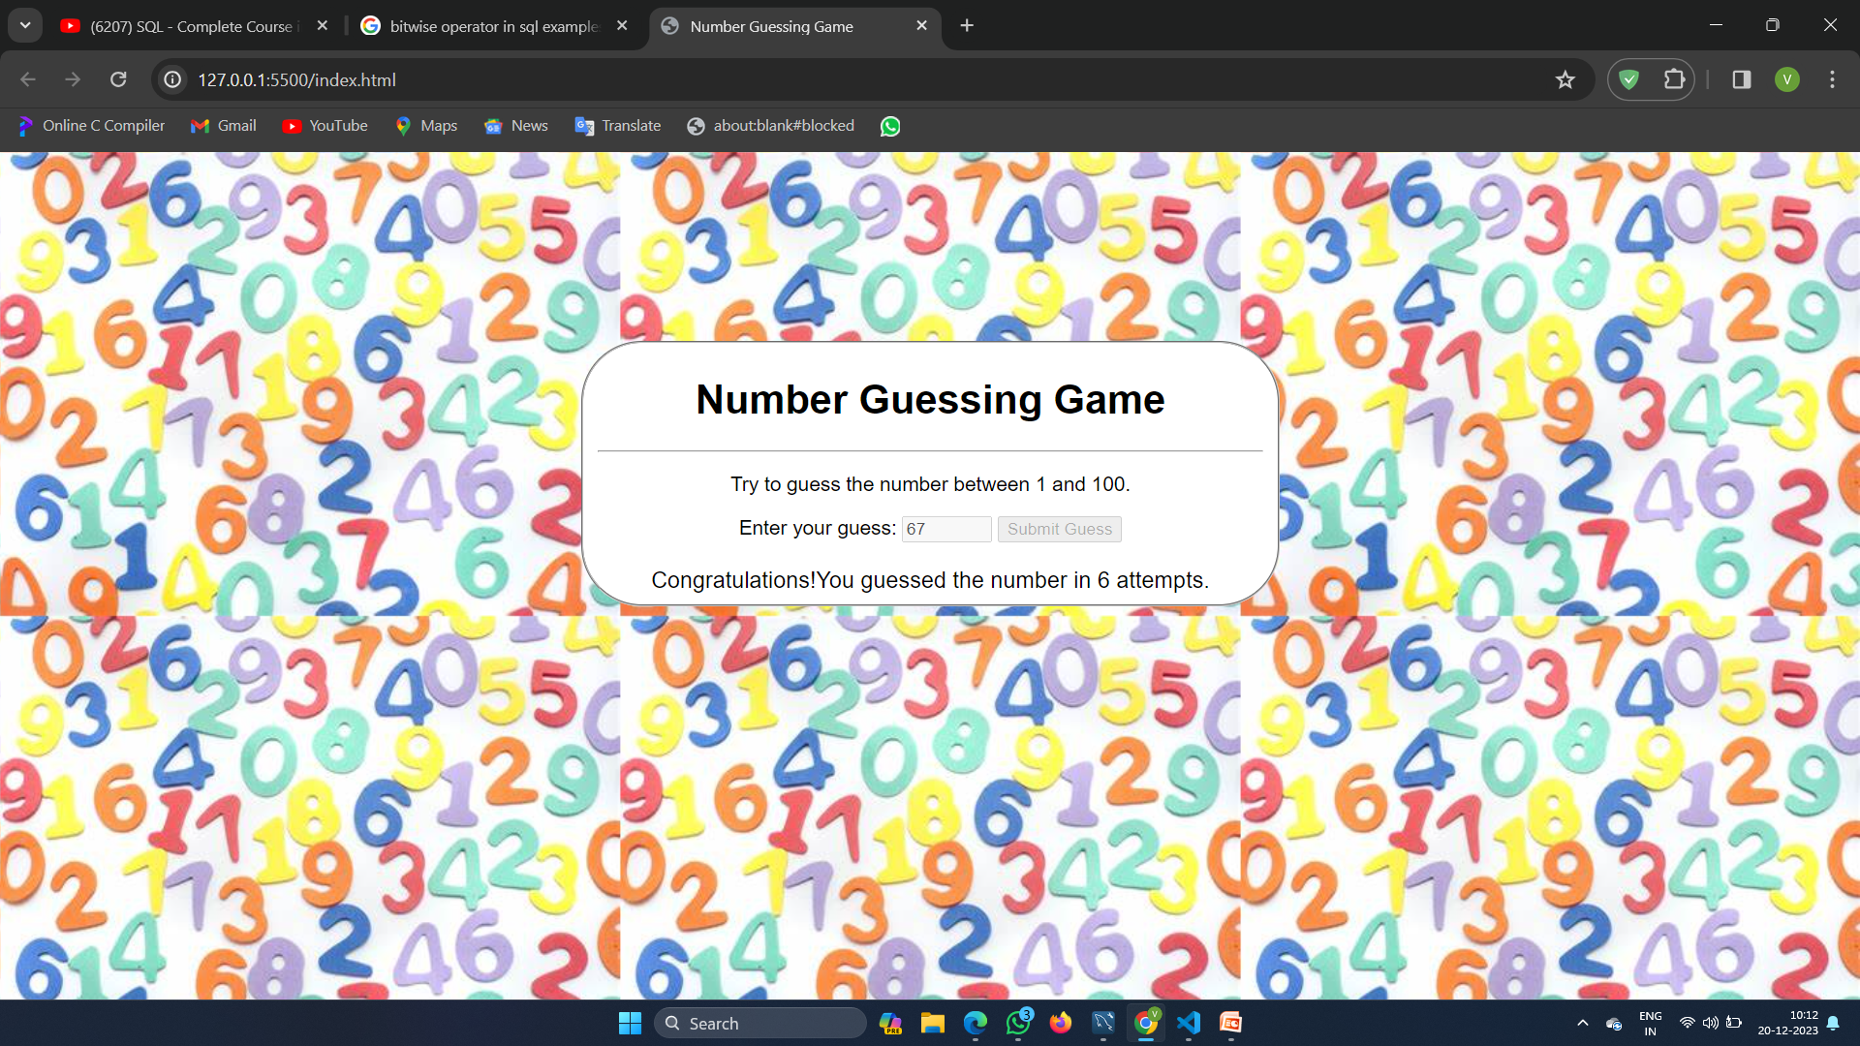

Slide 14
Thank you!
Notes:
thank you very much for joining this PPT, keep learning.
14

